Slide 1
Integration Team 10
(CICS, source)
By: Joshua Evers, Daniel Hawkins, Ismail Uddin, Robert Wright, Don Young

Slide 2
Integration Flowchart
Data being pulled:
StudentID
FirstName
LastName
DOB
GPA
Major
AddDate
ChangeDate
ChangeTime
Mainframe
Web Service
TXSeries C#
Software AG
Publish Document

Slide 3
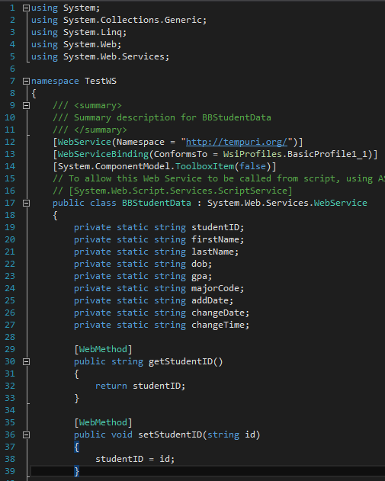
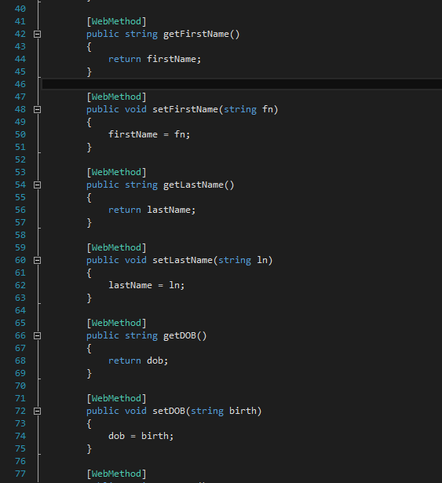
Integration Code
Program created which creates a web service for storing data

Slide 4
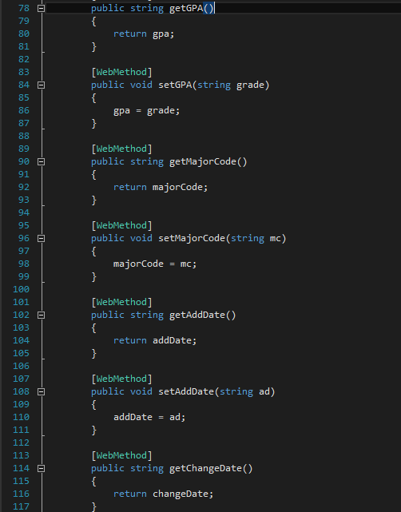
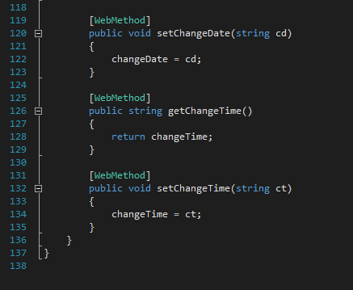
Integration Code (continued)

Slide 5
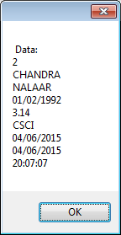
Integration Output

